Slide 1
Microprocessor Application Syllabus
Target Audience: junior of School of CSEE
Prerequisite: C, Logic Design, Computer Architecture
Target Device: ARM Cortex-M0 or M3 processor and boards
Main Material or Textbook: ??
Main topics to be covered
Part 0 ARM ISA – registers, memory map, I/O, interrupt, DMA, etc.
Part I ARM processor with ALP – simple arithmetic and data move
Part 2 Programming in C Language with ARM environment - others
Part 3 development RTOS environment – concurrency applications

Slide 2
Detail subjects to be covered
Simple Calculation (Adding integers, Search arrays, Moving data to/from memory block to registers)
Simple I/O wit LEDs and Switches using GPIO
Floating point arithmetic
Efficient C Programming in Embedded Systems
Interrupt Handling and Timer
Analog Interface (DAC, ADC) – music application
Direct Memory Access and cache issues
Serial Communication (UART, ISP, I2C)
Wireless Communication (BLE or Wifi)

Slide 3
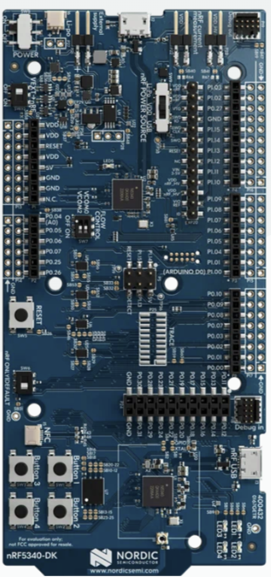
Nordic nRF 5340DK
Key features
Supports Bluetooth Low Energy, Bluetooth mesh, NFC, Matter, Thread and Zigbee
User-programmable LEDs(4) and buttons(4)
2.4 GHz and NFC antennas
SWF RF connector for direct RF measurements
On-board SEGGER J-Link debugger/programmer
Arduino Uno Rev3 form factor
Pins for measuring power consumption
1.7-5.0 V supply from USB, external, Li-Po battery or CR2032 coin cell battery

Slide 4
Questions?
Textbook
Tutorials for very beginner
Youtube lectures?
Materials in English ?
Side boards for peripherals and other devices for experiments
Reward (payment) to the Efforts of Technonia
Schedule
Due: before beginning of Spring semester 2024
1st revision by 2024. Feb.
Last revision 2024 Summer vacation season.

